Slide 1
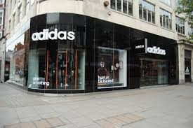
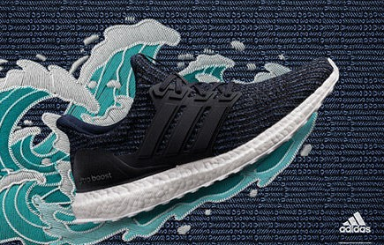
Adidas US Sales Report
Presented By:
Praise Victor.

Slide 2
Background
Methodology
Analysis
Insight
Conclusion and Recommendation
TABLE OF CONTENT

Slide 3
B
A
C
K
G
R
O
U
N
D
The Adidas US Store, a subsidiary of the Adidas Group, specializes in the sales of men’s apparel, women’s apparel, men’s athletic footwear, women’s athletic footwear and the likes.
Data has been gathered on the sales of these products including the number of units sold, total sales revenue, the location of the sales, the type of product sold, and any other relevant information.
However, this data has not been evaluated by the company.

Slide 4
M
E
T
H
O
D
O
L
O
G
Y
September 09, 2024
September 11, 2024
September 13, 2024
September 14, 2024
1
2
3
4
Data and Requirement gathering
Data cleaning
Data Analysis
Report
Data collection
Understanding the business problem
Exploratory data analysis
Data quality issues
Visualization
Analysis
Insight
Recommendation

Slide 5
Data Collection:
The data used in this analysis was collected on September 09, 2024.
Data Cleaning:
No null or duplicate values were found in this data, however, additional columns were added to gain more insights into the data and provide answers to the analytical questions. The added columns are Day and Month.
Data Visualization:
After the process of data cleaning, Microsoft Excel’s Pivot Table and Chart were used to visualize the data. Below are some of the charts:
M
E
T
H
O
D
O
L
O
G
Y

Slide 6
A
N
A
L
Y
S
I
S
The purpose of the analysis is to evaluate the sales performance in the Adidas US stores in each city and region of the country. This was also done to understand the behavioural pattern and purchasing habits of their customers.

Slide 7
A
N
A
L
Y
S
I
S
This data shows the regional sales pattern in the US Stores with the Western region making the most sales.

Slide 8
A
N
A
L
Y
S
I
S
This data shows the daily sales pattern in the US Stores with the most sales being made every Friday.

Slide 9
A
N
A
L
Y
S
I
S
This data shows the method most customers utilize to purchase products from the stores. In this chart, we can deduce that most customers prefer to shop online.

Slide 10
A
N
A
L
Y
S
I
S
This data shows the best selling product which is the Men’s Street Footwear making sales worth $208,826,244.

Slide 11
A
N
A
L
Y
S
I
S
This data shows the top performing cities in terms of profit, with Charleston making the most profit and New York following behind.

Slide 12
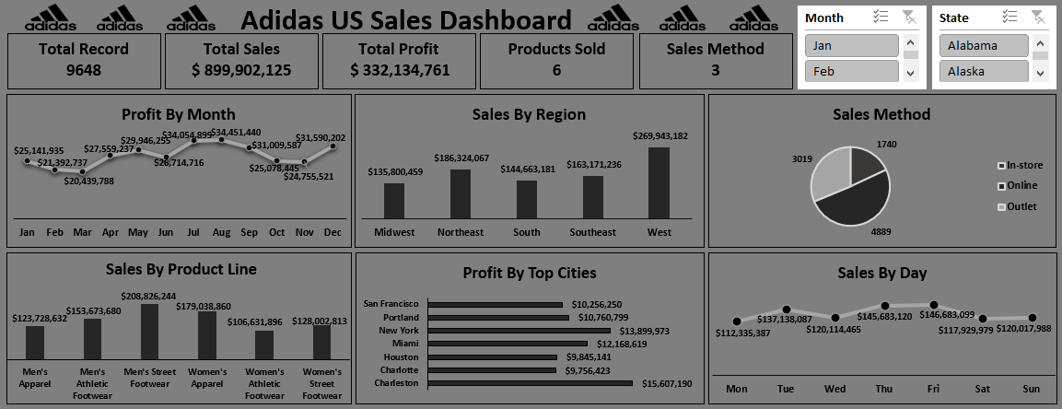
I
N
S
I
G
H
T

Slide 13
R
E
C
O
M
M
E
D
A
T
I
O
N
With Friday being the day most sales are made in a week, each store should ensure there’s no shortage of any product that particular day. The staff members should also be readily on site to attend to every customer.
Knowing most customers purchase products online, the store’s website should be well-functioning 24/7. Ads can also be created for more publicity and sales promotion.
The best selling product till date remains the Men’s Street footwear, therefore, each store branch in the US should always have this product in stock.
Since Charleston is the most performing city in terms of profit, the sales strategy used should be shared with the store branches in cities that are not as profitable.
Further analysis should be made on the stores in the Western region to determine what the best sales strategy is and how it can be implemented in less profitable regions.

